Slide 1
MySQL Project for Managing a small Library
By-Mohit Kulhari

Slide 2
Project Overview
In this project we create a database management system for managing a small library and some queries are also solved so as to have an idea how the system works.

Slide 5
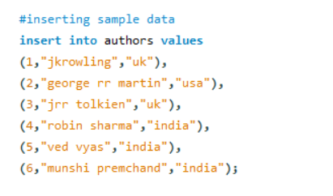


Slide 6



Slide 7


Slide 8


Slide 9


Slide 10


Slide 11
A few Questions

Slide 12

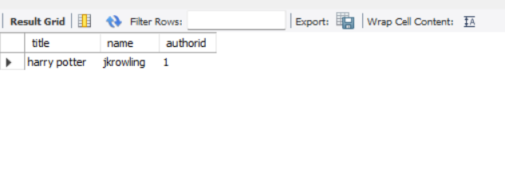

Slide 13

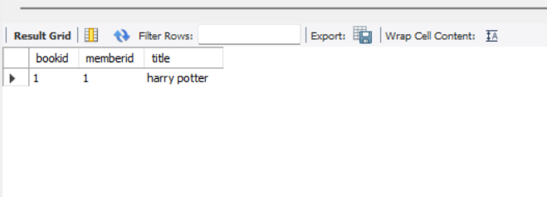

Slide 14
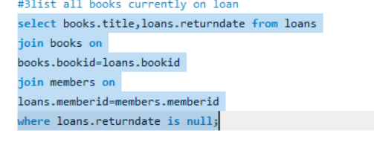


Slide 15



Slide 16

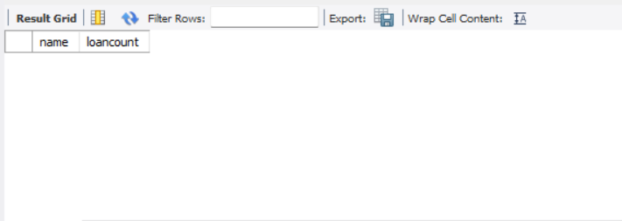

Slide 17

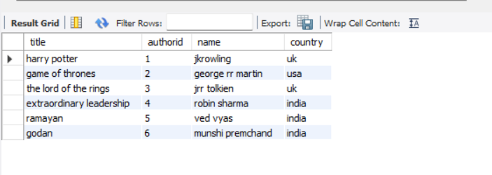

Slide 18



Slide 19



Slide 20

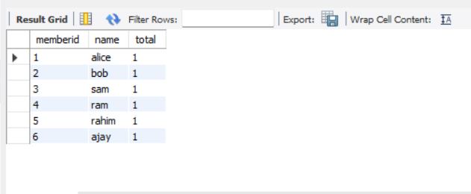

Slide 21
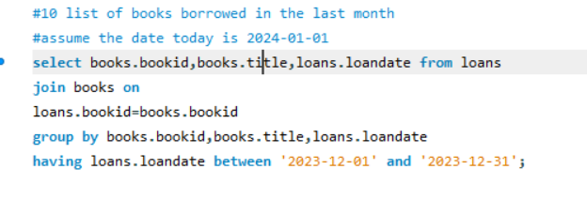


Slide 22

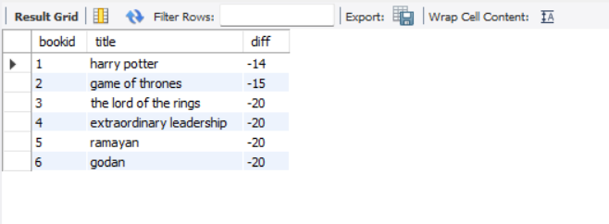

Slide 23

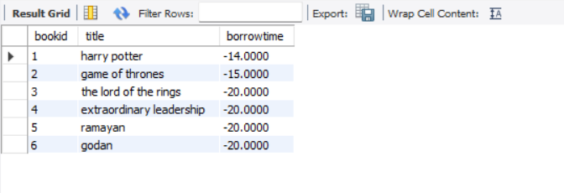

Slide 24



Slide 25
Link to source code
sql_projects/library project.sql at main · Mohit-exe/sql_projects (github.com)

